Slide 2
Java Coding Quality
7th Launch Program
10|01|2016
4

Slide 3
AGENDA
What and Why is Java?
What and Why is Java Coding Quality?
What and Why is “Clean Code” in Java?
How to write Clean Code
Meaningful Names
Functions
Comments
Coding Conventions
Error Handlings
Unit-testing
Assignment
Code Quality for Java Programming

Slide 4
What is Java?
Write one run every
OOB (Abstraction, Encapsulation, Polymorphism, Inheritance)
C like language -> Easy to understand

Slide 5
What & Why is Java Coding Quality?
What is Java Coding Quality?
SOLID principles
Clean code
Secure
Why is Java Coding Quality?
Less bug and easier to maintain
Code Quality for Java Programming

Slide 6
What is ‘Clean Code’?
“Clean code is code that is easy to understand and easy to change”
Easy to understand:
The execution flow of the entire application
How the different objects collaborate with each other
The role and responsibility of each class
What each method does
The purpose of each expression and variable
Easy to change:
Classes and methods are small and only have single responsibility
Classes have clear and concise public APIs
Classes and methods are predictable and work as expected
The code is easily testable and has unit tests
Tests are easy to understand and easy to change
Clean Code
Notes:
Bjarne Stroustrup, inventor of C++: I like my code to be elegant and efficient.
Grady Booch: Clean code is simple and direct. Clean code reads like well-written prose.
Dave Thomas, Eclipse: Clean code can be read, and enhanced by a developer other than its original author.
Michael Feathers: Clean code always looks like it was written by someone who cares.
Ward Cunningham, inventor of Wiki: You know you are working on clean code when each routine you read turns out to be pretty much what you expected.

Slide 7
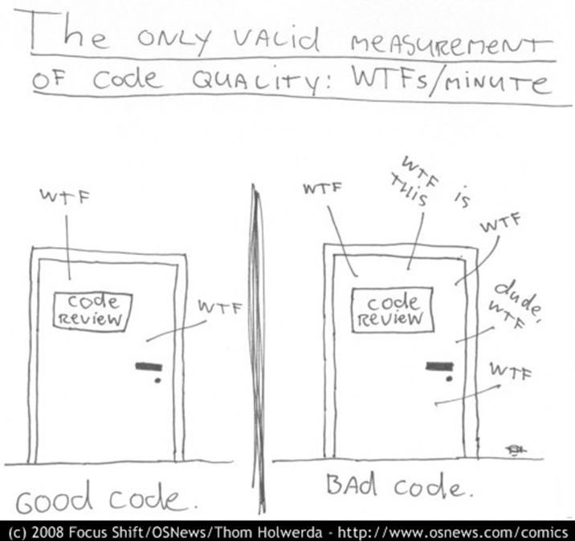
Why is ‘Clean Code’?
You are a programmer
You want to be a better programmer
You like being part of best teams
“Later equals never”
Clean Code

Slide 8
Writing Clean Code

Slide 9
Meaningful Names
Use intention-revealing names
Avoid disinformation
Make meaningful distinctions
Use pronounceable names
Use searchable names
Classes and objects should have noun or noun phrase names
Methods should have verb or verb phase names
Fields should have adjective names
Professionals use their powers for good and write code that others understand.
Writing Clean Code
Notes:
Use intention-revealing names: variable in loop such as for (f in files) and for (f in fields)
Avoid disinformation: using acronym such as cco (Code Check Out)
Make meaningful distinctions: file and folder in Unix file system are judged the same, but they have different meanings.
Use pronounceable names: easier to remember and communicate to others.
Use searchable names
Classes and objects should have noun or noun phrase names
Methods should have verb or verb phase names
Fields should have adjective names

Slide 10
Meaningful Names - Sample
public List<int[]> getThem() {
List<int[]> thm_ls = new ArrayList<int[]>();
for(int[] x : m_theList) {
if(x[0] == 4)
thm_ls.add(x);
}
return thm_ls;
}
public List<Cell> getFlaggedCells() {
List<Cell> flaggedCells = new ArrayList<Cell>();
for(Cell cell : gameBoard) {
if(cell.isFlagged()) {
flaggedCells.add(cell);
}
}
return flaggedCells;
}
Writing Clean Code

Slide 11
Functions
Should be small (limit in 150 characters per line, 20 lines per function)
Do one thing
Don’t repeat yourself
Polymorphism over If/Else or Switch
Function arguments that more than three should be wrapped into a class of their own.
The first rule of functions is that they should be small
Writing Clean Code
Notes:
Polymorphism over If/Else or Switch: make coffee with different recipes (e.g. Latte, Cappuccino, Americano):
Bad code:
if type=Latte then follow Latter recipe
else if type = Cappuccino then follow Cappuccino recipe
else if type = Americano then follow Americano recipe
Good code:
coffee = RecipeFactory.get(typeName)
coffee.make()
Function arguments that more than three should be wrapped into a class of their own:
Telescope:
f(a) { f(a, null) }
f(a, b) { f(a, b, null) }
f(a, b, c) {take action with a, b, c}

Slide 12
Comments
Don’t comment bad code, rewrite it!
Explain yourself in code
Good Comments
Warning of consequences
TODO Comment
Bad Comments:
Redundant comment
Closing brace comment
Commented-out code
Every time you write a comment, you should grimace and feel the failure of your ability of expression.
Writing Clean Code

Slide 13
Coding Conventions
Team-defined Coding Convention
KMS Coding Standards
https://intranet.kms-technology.com/pages/viewpage.action?pageId=6324712
Java Coding Standards
https://google.github.io/styleguide/javaguide.html
http://www.oracle.com/technetwork/java/index-135089.html
Strictly follow your project’s formatting rules to keep everything consistent
Writing Clean Code

Slide 14
Error Handling
Use exceptions rather than return codes
Write your try-catch-finally statement first
Use unchecked exceptions
Provide Context with Exceptions
Don't return Null
Don't pass Null
Writing Clean Code

Slide 15
Unit-Testing
The three laws of TDD
Take care of tests
Don’t skip trivial tests
Don’t do ONLY trivial tests
Tests the limits/boundaries of the conditions
Keep test clean
Test code is just as important as production code. It must be kept as clean as production code.
Writing Clean Code
Notes:
3 laws of TDD
You can't write any production code until you have first written a failing unit test.
You can't write more of a unit test than is sufficient to fail, and not compiling is failing.
You can't write more production code than is sufficient to pass the currently failing unit test.
Unit test is like a vise when you optimize and add new feature ~ Michael Feathers.

Slide 16
“Always code as if the guy who ends up maintaining your code will be a violent psychopath who knows where you live.“ - John F. Woods
Writing Clean Code

Slide 17
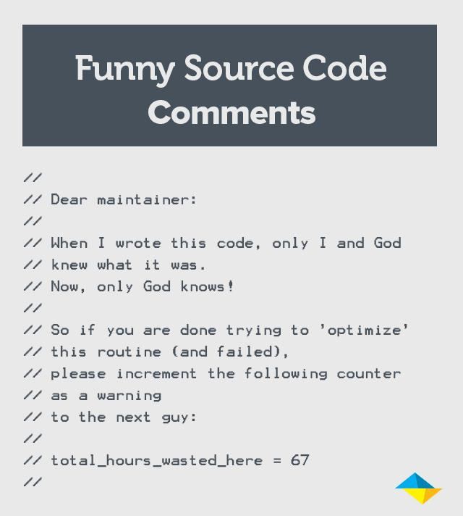
Writing Clean Code

Slide 18
Assignment

Slide 19
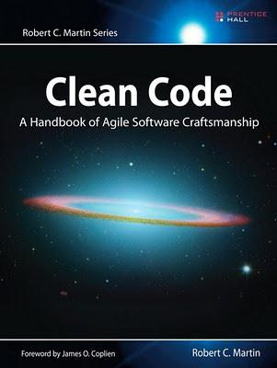
Reading ‘Clean Code’ book
Chapter 2: Meaningful Names
Chapter 3: Functions
Chapter 4: Comments
Chapter 5: Formatting
Chapter 7: Error Handlings
Chapter 9: Unit-testing
Chapter 17: Smells and Heuristics
Assignment

Slide 20
Applying KMS Java Coding Standards
https://intranet.kms-technology.com/download/attachments/6324712/KMS%20Java%20Coding%20Standards%20-%20v1.0.docx?api=v2
Assignment

Slide 21
Practice ‘Clean Code’
Source code: https://git.kms-technology.com/kms-launch/launch-07-java-code-quality
Finding ‘Smell’ code
Refactoring code
Assignment

Slide 22
Q & A
Java Coding Quality and Techniques

